Slide 1
Minimum Cost Flow Problem
Production/Distribution Problem

Slide 2
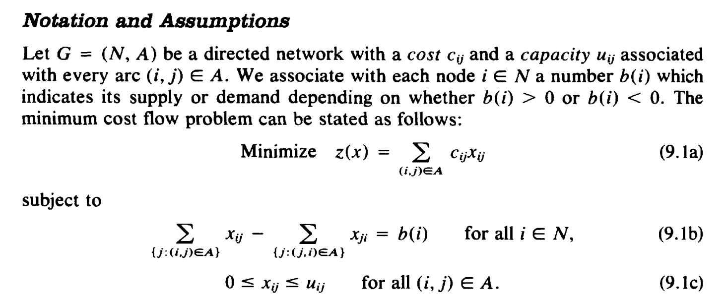
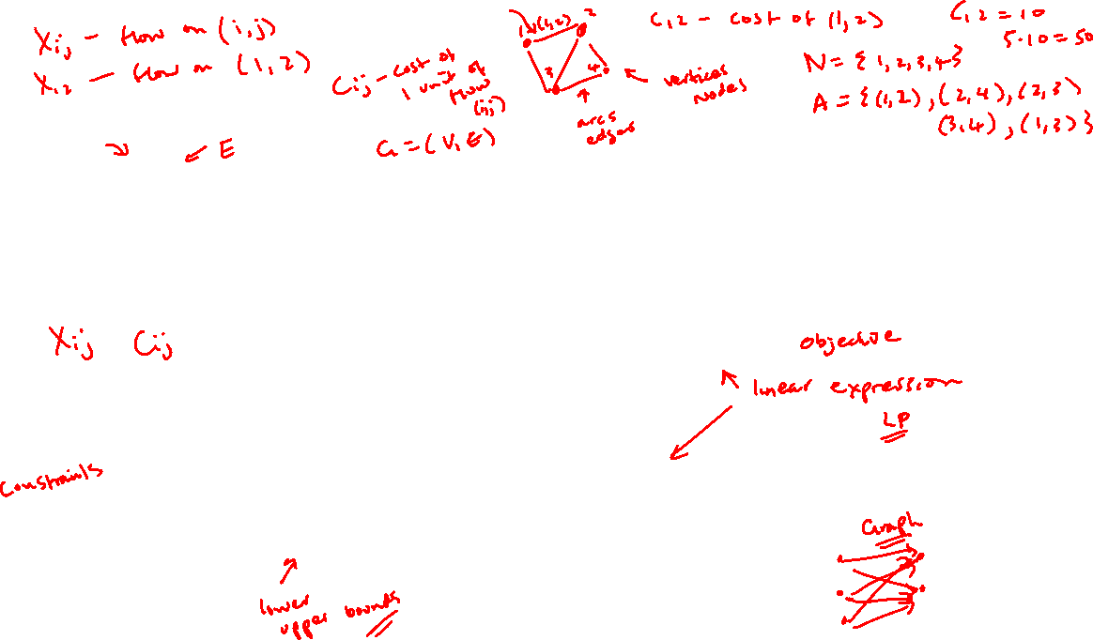

Slide 3
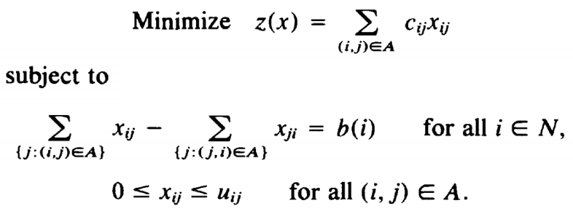
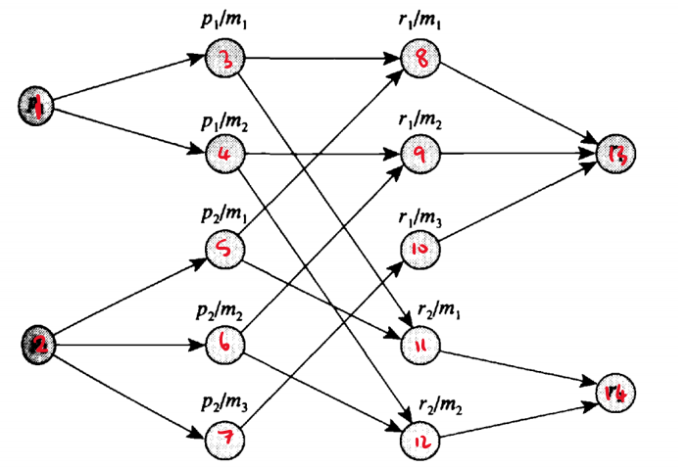
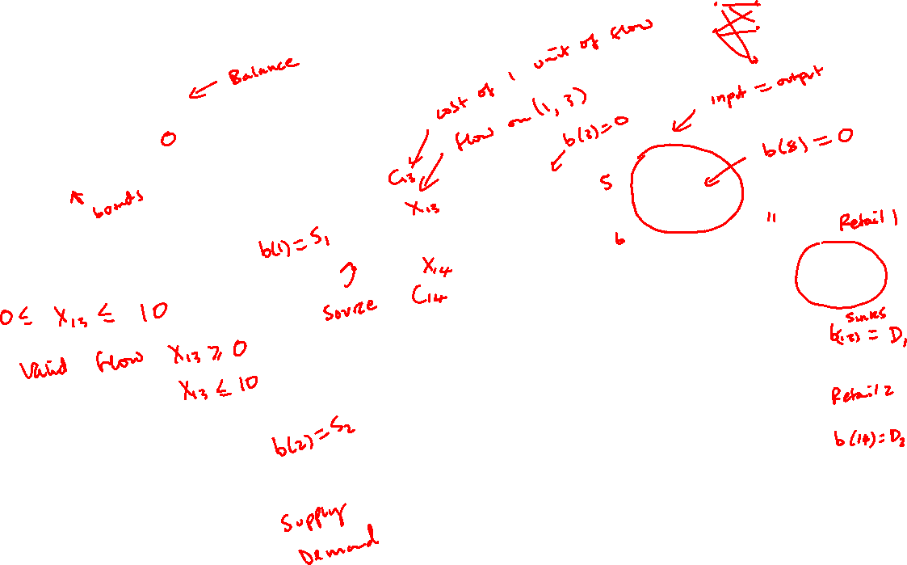

Slide 4
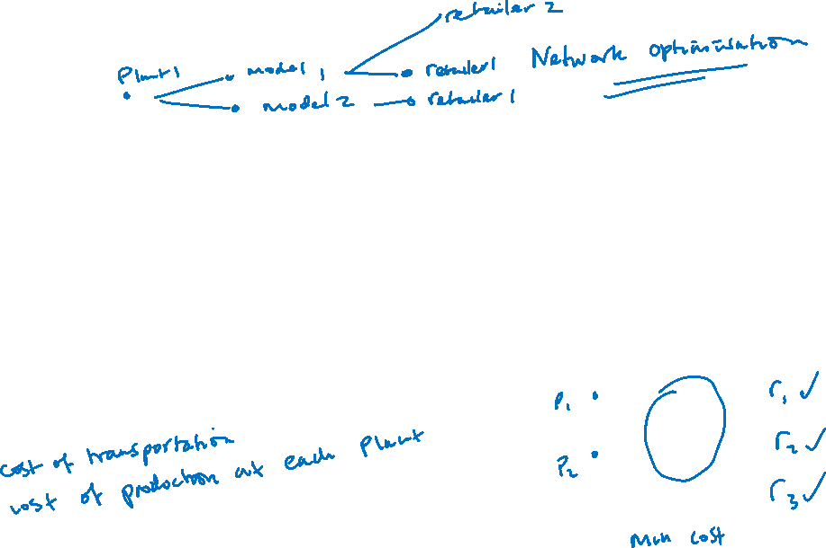
Production/Distribution Problem
A car manufacturer has several manufacturing plants and produces several car models at each plant that it then ships to geographically dispersed retail centers throughout the country.
Each retail center requests a specific number of cars of each model.
The firm must determine the production plan of each model at each plant and a shipping pattern that satisfies the demands of each retail center and minimizes the overall cost of production and transportation.

Slide 5
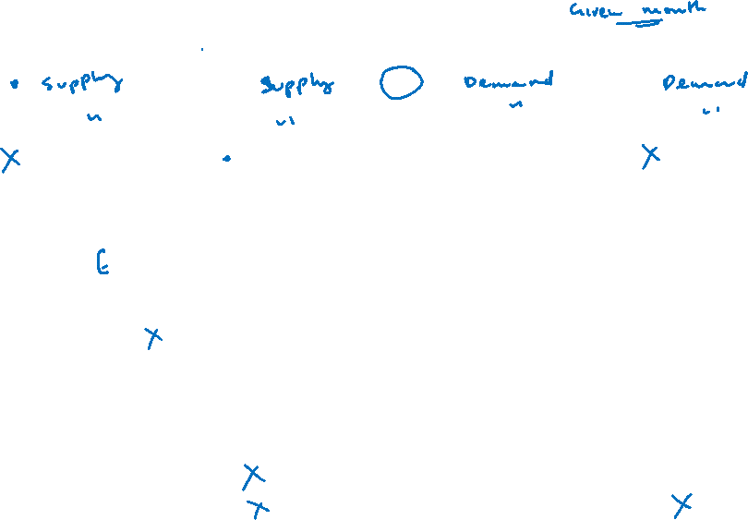
Production/Distribution Demands and Costs
Supply/Demand
 | Plant 1 | Plant 2 | Retailer 1 | Retailer 2
Model 1 | 150 | 100 | 100 | 100
Model 2 | 120 | 150 | 80 | 130
Model 3 | - | 100 | 70 | -
Cost of Production
 | Plant 1 | Plant 2
Model 1 | 1000 | 900
Model 2 | 1200 | 1100
Model 3 | - | 1500
Cost of Transportation
 | Plant 1 |  |  | Plant 2 |  | Retailer 2
 | Model 1 | Model 2 | Model 3 | Model 1 | Model 2 | Model 3
Retail 1 | 4 | 3 | - | 5 | 4 | 4
Retail 2 | 5 | 6 | - | 6 | 3 | -

Slide 6
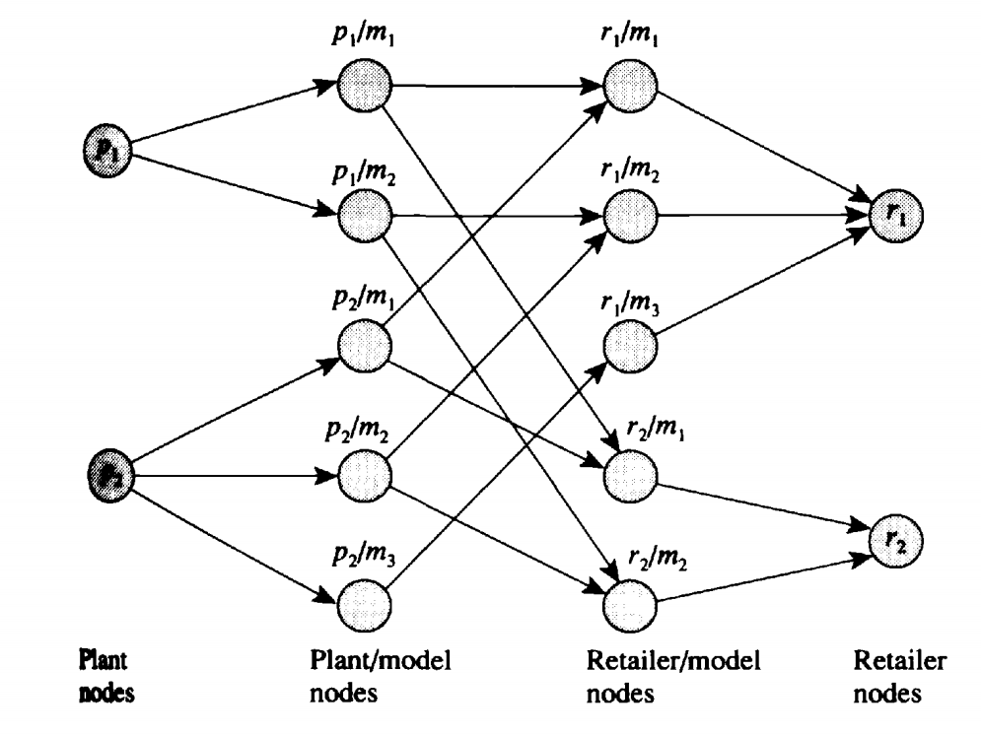

Slide 7
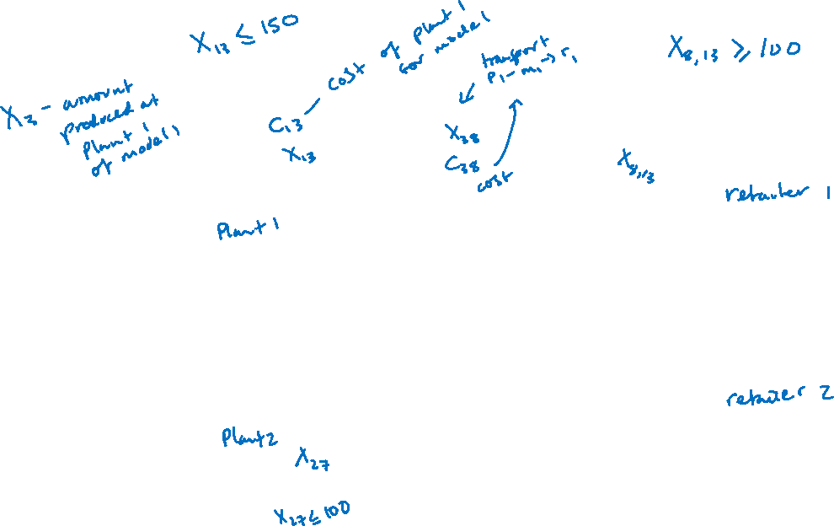

Slide 8

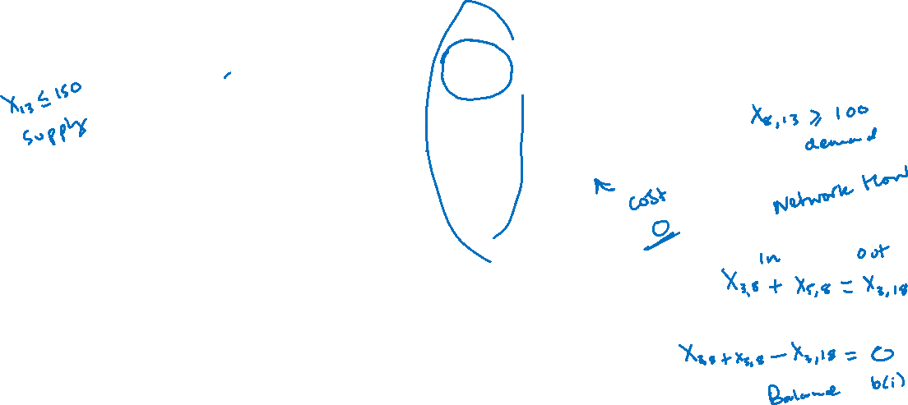



Slide 9
Production/Distribution Demands and Costs
 | Plant 1 | Plant 2 | Retailer 1 | Retailer 2
Model 1 | 150 | 100 | 100 | 100
Model 2 | 120 | 150 | 80 | 130
Model 3 | - | 100 | 70 | -
 | Plant 1 | Plant 2
Model 1 | 1000 | 900
Model 2 | 1200 | 1100
Model 3 | - | 1500
 | Plant 1 |  |  | Plant 2 |  | Retailer 2
 | Model 1 | Model 2 | Model 3 | Model 1 | Model 2 | Model 3
Retail 1 | 4 | 3 | - | 5 | 4 | 4
Retail 2 | 5 | 6 | - | 6 | 3 | -

Slide 10
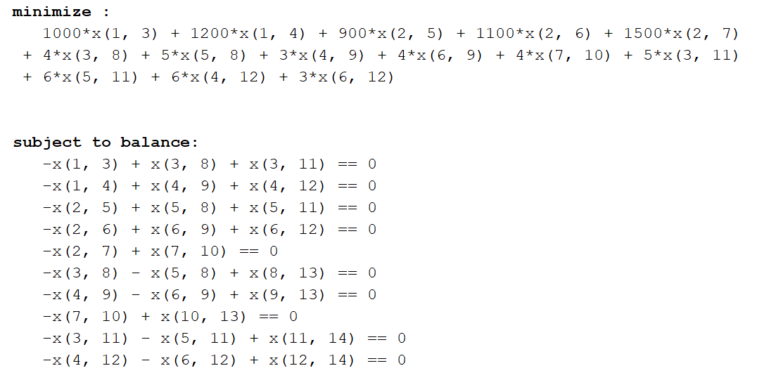
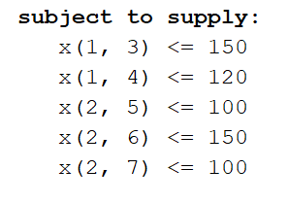
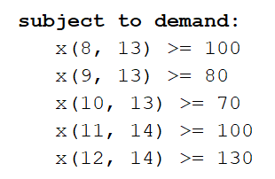
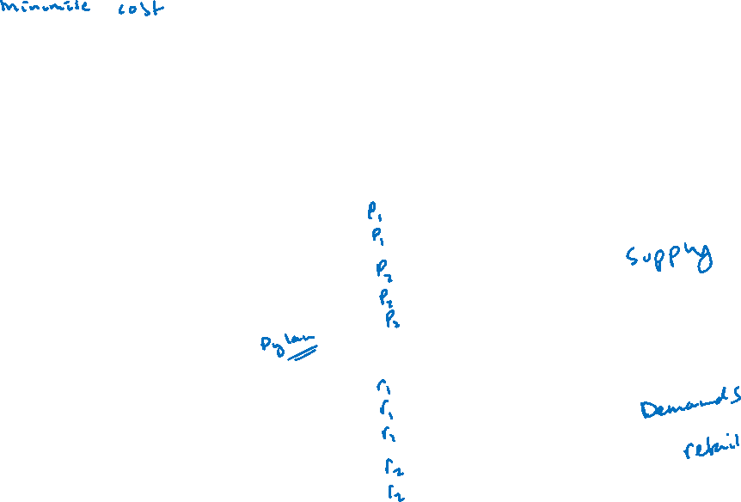

Slide 11

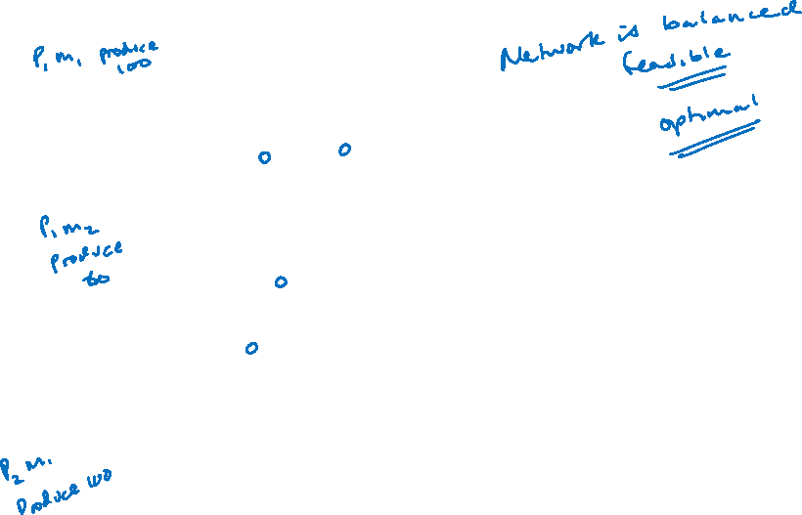

Optimal Solution Via MATLAB

